Slide 1
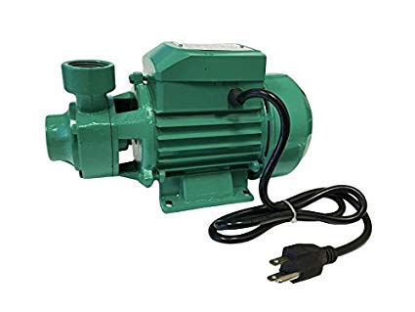

EMP’s zooplankton monitoring
Three types of gear used per station
Field sampling –
Sled with a 10-minute stepped oblique tow. Both the mysid net and CB net are on the same sled.
Pump with a vertical tow.
“CB” net – 160 um
“mysid” net – 500 um
v
v
“pump” – 43 um

Slide 2

EMP’s zooplankton monitoring
Lab methods
All mysids and amphipods are conted and identified. Only mysid data is shared publically.
mysids
All copepods, cladocerans, and rotifers are counted and identified. Theoretically this should be similar to the “large size fraction” of the pump sample, but the gear will be able to capture these larger, more mobile things better. It can’t capture the very large critters (like mysids) efficiently, so incidental catch of mysids is not recorded.
CB
150 um sieve
Large size fraction, counted and identified but not reported to the public
pump
43 um sieve
Small size fraction, reported

Slide 3
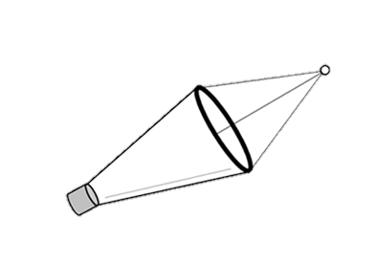
Rosie’s conversion factor
150 um sieve
25% of the Limnoithona were in in this size fraction
Conversion factor is 0.25
pump
43 um sieve
75% of the Limnoithona were in in this size fraction
These two numbers are now on the same “mesh size” scale
The Aquatic Veg study just used a 50 micron net.
120 Limnos
120 *0.25
30 Limnos
Multiply by conversion factor to compare the two studies
15 Limnos
15 Limnos
FRP just used a 150 micron mesh net

Slide 4
Caveats
This assumes the 150 um mesh sieve works the same way as a 150 um mesh net.
This does not account for larger critter escaping the pump
The conversion factor is likely to vary with environmental conditions
We should probably see how the CPUE of the large size fraction compares to the CPUE of the CB net.

